Slide 1

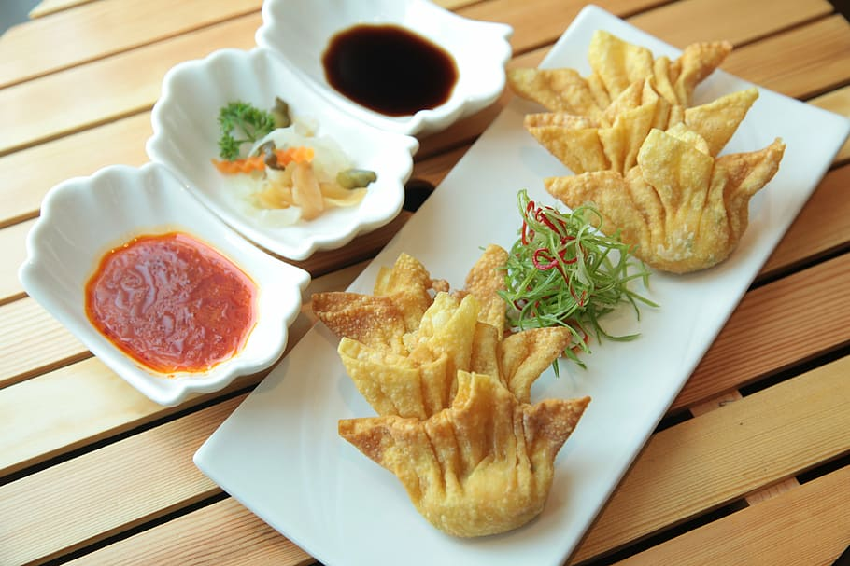
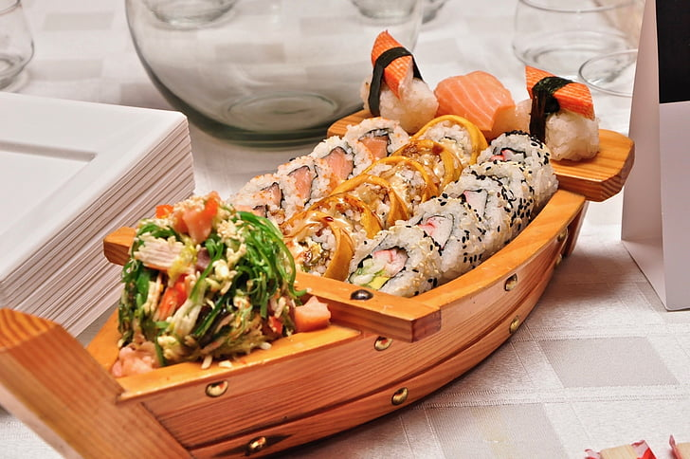
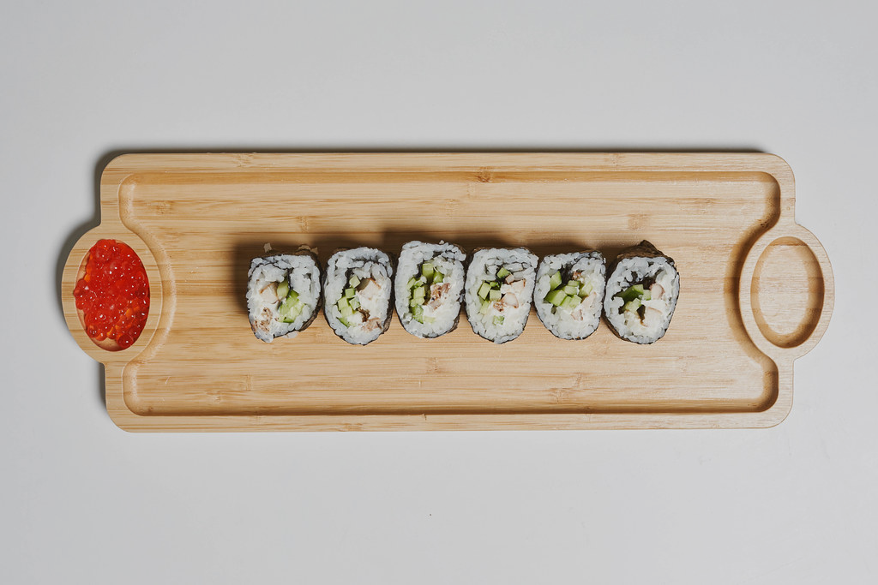
Restaurant Business Recommendation
Spring Team 454
(Aishwarya, Eva, Rahat, Rohan, JC)

Slide 2
Agenda
Background
Data Preparation
Exploratory Data Analysis(EDA)
Sentiment Analysis
Topic Modelling
BERT Zeroshot Modelling
Recommendations

Slide 3
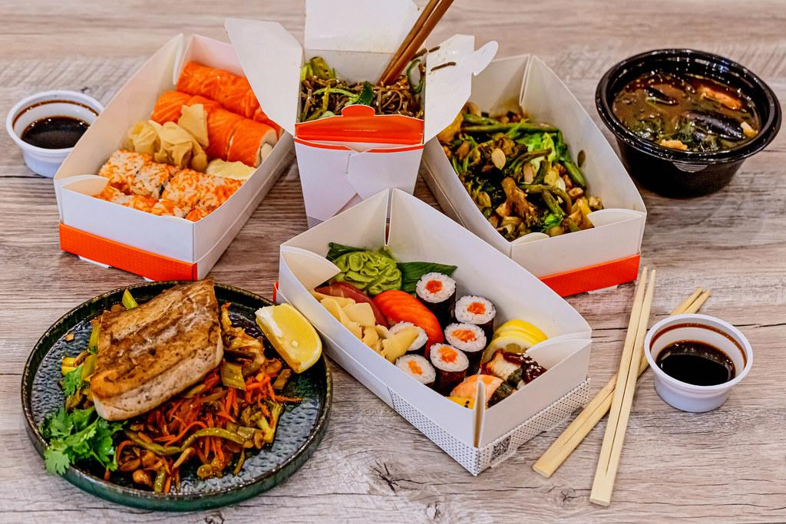
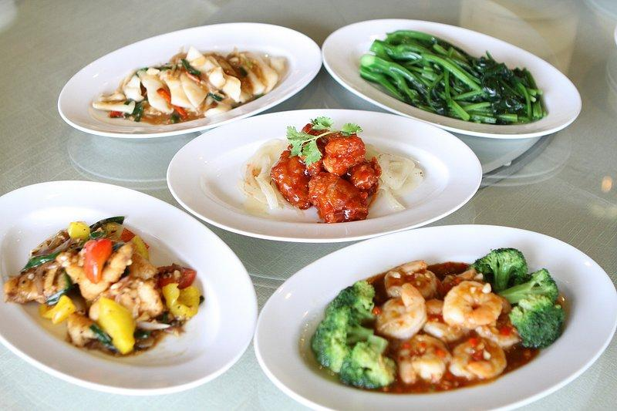

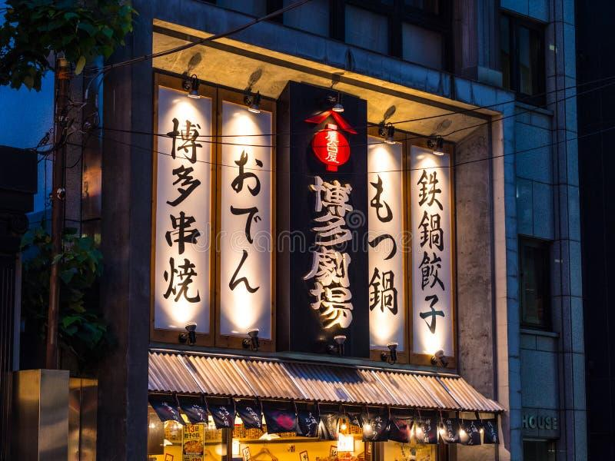
Problem Statement
Our project’s motive is to recommend a business owner to make a strategic investment in a restaurant.
We are going to recommend the type of cuisine to choose and where to set the restaurant up.

Slide 4
Data Preparation
Dataset Filtering: Initially, the entire business dataset, which likely contained information on a wide variety of businesses, was filtered to select only those entries with 'Japanese' in the 'categories' field. This is a critical step to narrow down the dataset to the specific niche of interest.
String Matching: The filtering method used involves string matching within the 'categories' column of the business dataset. By using the str.contains("Japanese", na=False) method, all businesses not related to Japanese cuisine are excluded, while also handling any missing values (NA values are ignored).
Merging Datasets: The code also indicates that there are separate datasets for businesses and reviews. By filtering the business dataset to get the IDs of Japanese restaurants and then selecting only the reviews with these business IDs, the data is further refined to include only relevant reviews.
Data Extraction: After filtering the businesses and reviews, the relevant subset of data is saved into a new CSV file, FL_japanese_restaurants.csv. This step ensures that the cleaned and focused dataset is easily accessible for future analysis, without the need to repeat the filtering process.
Data Consolidation: The code shows an understanding of working with different file formats and sources, as seen with the inclusion of a JSON file containing a comprehensive business dataset. This data consolidation process is key in creating a singular, clean dataset for Japanese restaurants that can be used for sentiment analysis or other forms of data-driven decision-making.

Slide 5
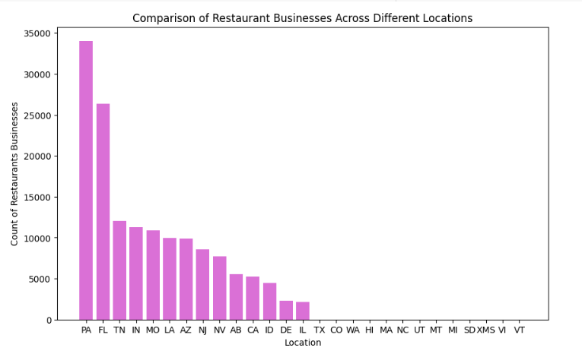
Why Florida?
Comparing Restaurant Businesses Across different states
Second highest restaurant businesses
Asian fusion restaurant as a hot topic
Tourism Industry: Florida is a major tourist destination, attracting millions of visitors each year. Tourists often seek out authentic international dining experiences, and a Japanese restaurant can cater to their preferences.

Slide 6
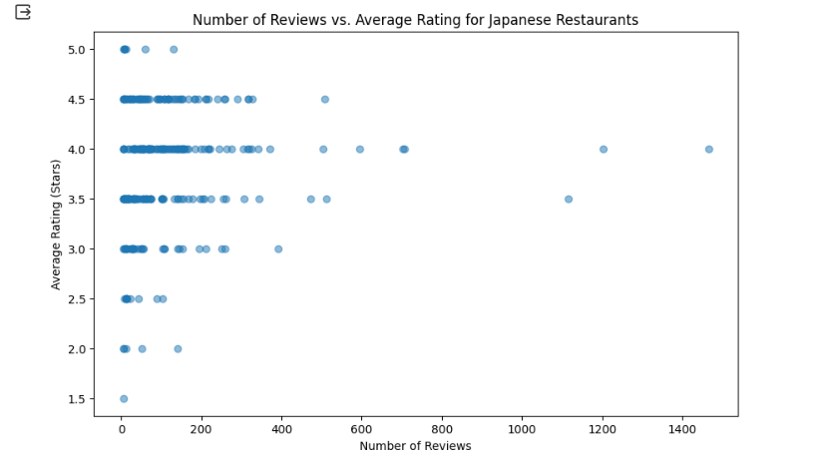
Insights after EDA
1.Average Rating for all restaurants in FL: 3.6109570831750855
2.Average Rating for Japanese restaurants in FL: 3.8125
3.Japanese restaurants are rated higher on average than other restaurants in Florida, indicating a preference among customers.

Slide 7
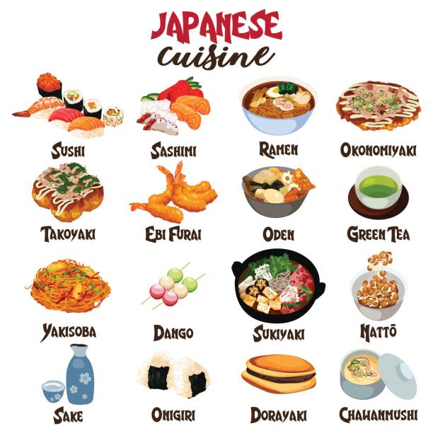
Types of Japanese Food

Slide 8
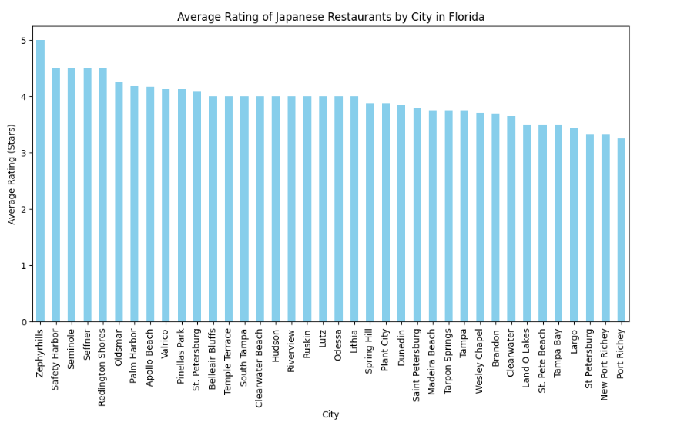
Average Ratings by Cities
Tourist Area Ratings: Cities known for tourism, such as Tampa, might have lower average ratings for Japanese restaurants. This could indicate a market saturated with dining options where quality isn't always the top priority, or it might reflect a diverse customer base with varying expectations.
Investment Opportunity: The lower ratings in tourist-heavy areas might represent an opportunity to introduce a high-quality Japanese dining experience. Focusing on exceptional service, authentic cuisine, and a unique dining atmosphere could fulfill an unmet demand and potentially draw both tourists and locals looking for a premium experience.

Slide 9
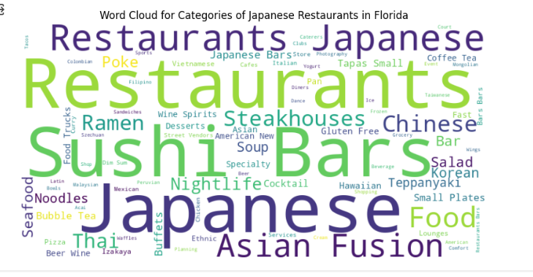
Word Cloud for Categories of Japanese Restaurants in Florida
1. Diverse Menu:Highlighting "Sushi," "Ramen," "Noodles," and "Teppanyaki" suggests a demand for varied Japanese cuisine, indicating the importance of a diverse menu for competitiveness.
2. Fusion Cuisine:The mention of "Fusion" with "Japanese" and "Asian" points to interest in cross-cultural culinary blends, presenting a potential niche market.
3. Health Focus:The appearance of "Gluten Free" and "Salad" reflects a trend towards healthier dining options within Japanese cuisine.
4. Authentic Experience: The term "Izakaya" highlights consumer interest in genuine Japanese dining experiences, emphasizing the value of culture and atmosphere.
5. Evening Offerings: The presence of "Nightlife," "Cocktail," and "Bar" suggests benefits for Japanese restaurants offering a strong drinks menu and a nightlife-friendly setting.
Word cloud:

Slide 10
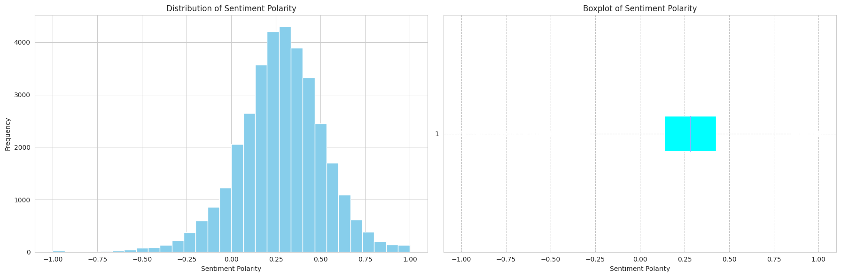
Sentiment Polarity using TextBlob
-> What we understand from the plots?
Positive skew in the Histogram: Most reviews are positive, with fewer neutral or negative reviews.
Boxplot centering above 0: The median sentiment is positive, reinforcing the idea that more reviews are positive than negative or neutral.
Outliers in Boxplot: These could represent exceptionally strong opinions (either very positive or very negative) that deviate from the majority of reviews.
Consolidated Analysis:
The text data overall has a neutral to slightly positive sentiment.
There is a normal distribution of sentiments with tails on both the positive and negative sides, but with few extremes.
The median sentiment is slightly positive, indicating that more than half of the text data leans towards a positive sentiment.
The compactness of the IQR suggests that most sentiments are concentrated around the median, with fewer sentiments having strong positive or negative polarities.

Slide 11
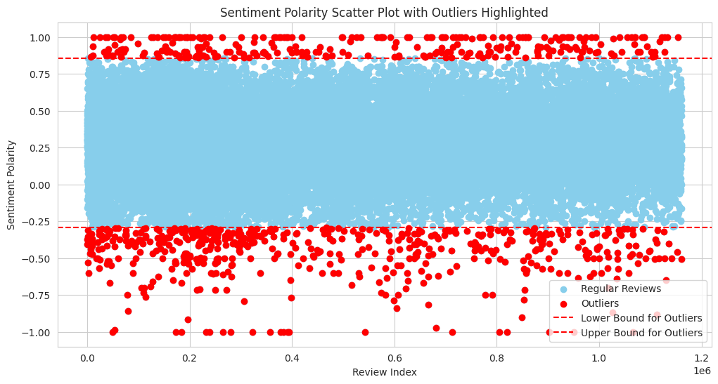
Sentiment Polarity of the Outliers
General Satisfaction: Most reviews are positive, indicating general customer satisfaction.
Presence of Extremes: Outliers suggest some exceptionally positive or negative experiences, likely linked to service quality or specific menu items.
Neutral Sentiments: A large number of neutral reviews may reflect mixed feelings or average experiences.
Negative Outliers: The fewer negative outliers still require attention to mitigate impact on reputation.
Improvement Opportunities: Analyzing negative outliers could reveal specific areas for restaurant improvement.

Slide 12
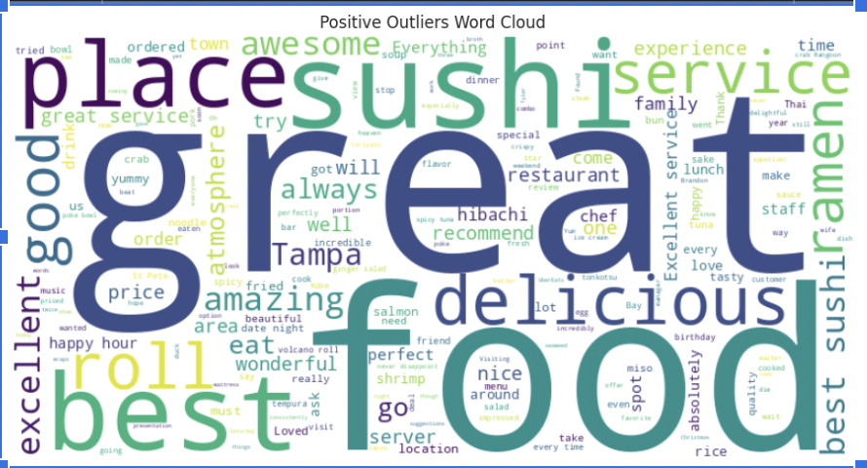
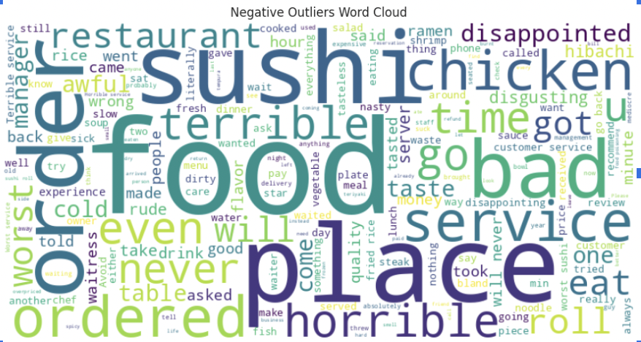
Comparing Negative and Positive Word-clouds
Service Quality: Inconsistent service experiences suggest a need for improvement.
Food Quality: Mixed reviews on "sushi" highlight a need for quality control.
Ambiance/Location: Positive reviews praise the location and ambiance, overshadowing these factors in negative reviews.
Value Perception: Concerns about cost in negative reviews, with positive experiences often justifying the price.

Slide 13
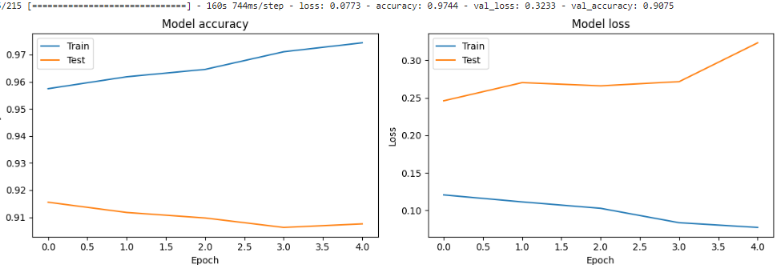
Sentiment Polarity of LSTM Model
Analysis from Accuracy and Loss Graph:
The model is learning and improving its performance on the training data over time, which is expected behavior.
However, the increasing test loss and the plateauing of test accuracy after a certain number of epochs indicate that the model may be overfitting. This means that while it is getting better at predicting the training data, its ability to generalize to new, unseen data is not improving and might even be worsening slightly after a certain point.
This could be addressed by implementing regularization techniques, adjusting the model's complexity, or using techniques like dropout or early stopping to prevent the model from overfitting.

Slide 14
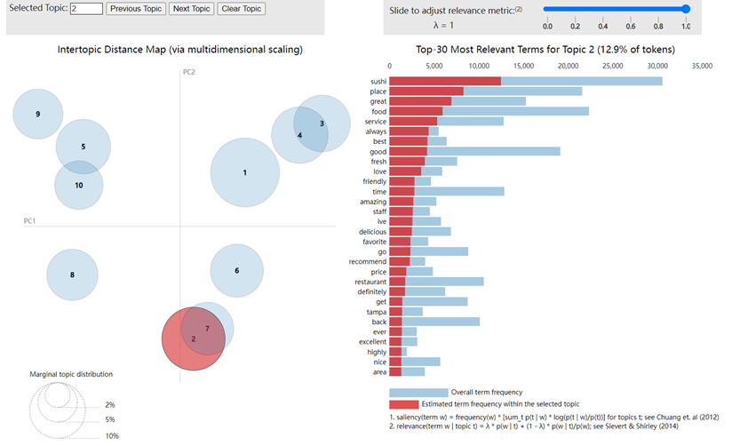
Topic modelling using Latent Dirichlet Allocation(LDA)
●Uncover common topics and latent topics from a collection of reviews: From florida Japanese reviews
●The size of the bubbles reflects the prevalence of the topic in the dataset– bigger means more prevalent
●2 and 7 overlap, similar themes discussed
●Relevance metric (λ), set to 1, highly specific and distinctive to Topic 2
●- Top three terms: sushi, place, great
●-Service, always, good, best , fresh
Notes:
JC’S PART
understanding customer feedback from reviews, what features are most talked about

Slide 15
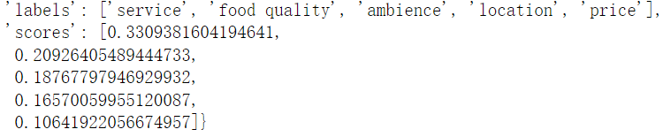
⁠Bert Zero Shot
Classify reviews into categories without training using BERT's zero-shot classification.
Advantage:
-Cost and Time Efficiency: no need to training models
-Flexibility in Topic Categorization :no need to retrain the model every time when having a new category of interest
What we got: The review text's relevance to each of the five categories
Notes:
JC’S PART2
This insight can help businesses understand what aspects are most relevant

Slide 16
Recommendations
Location Selection: Given that Japanese restaurants have a higher average rating than other restaurants in Florida, and considering the tourist demand in places like Tampa, opening a Japanese restaurant in such a locality could be a profitable venture. However, the presence of negative reviews in tourist areas signals the importance of location selection within these areas — aim for locations with high foot traffic but potentially less direct competition.
Diverse and Authentic Menu: Data suggests a high demand for a variety of Japanese cuisine. Include popular items like sushi, ramen, noodles, and teppanyaki, and ensure that the menu offers authentic flavors to stand out in the market. The presence of terms like "Izakaya" indicates a desire for an authentic dining experience, so consider including traditional Japanese dishes and a setting that reflects Japanese culture.
Incorporate Fusion Dishes: Interest in "fusion" suggests an opportunity to create a unique selling proposition by blending Japanese cuisine with elements of other Asian cuisines or local flavors, catering to diverse palates and those looking for a novel dining experience.
Health-Conscious Options: Including "Gluten-Free" options and salads can appeal to health-conscious diners, a growing demographic. Ensure these offerings maintain high quality and authenticity.

Slide 17
Recommendations (Continued)
Evening and Nightlife Offerings: The data shows a trend towards evening activities, indicating the potential for success with a strong drinks menu, cocktails, and a bar setting. This could also mean offering special events or promotions during evening hours to attract a nightlife crowd.
Quality and Freshness: Emphasize the freshness of ingredients, especially seafood like fish, salmon, and tuna, as these are frequently mentioned in positive reviews.
Customer Service: Pay special attention to service quality, as "service" and "wait" are prominent in the discussions. Training staff to provide excellent, prompt service can help in creating a positive dining experience that encourages repeat visits and word-of-mouth recommendations.
Efficient Operations: Address operational efficiency, as words related to waiting and service times ("wait," "came," "minutes") indicate that customers value prompt seating and serving. Streamlining kitchen and floor operations could enhance customer satisfaction.
Marketing Strategy: Use the positive sentiments found in reviews to market the restaurant. Highlighting words like "amazing," "friendly," "best," and "fresh" in marketing materials can resonate with potential customers' expectations.
Online Presence and Reviews: Maintain a strong online presence and encourage satisfied customers to leave positive reviews, as this can significantly impact the restaurant's reputation, especially in a tourist area where many customers rely on online ratings and reviews to make dining decisions.

Slide 18
Thank You

